Slide 1

Knowledge Distillation in Neural Networks
Team members:
Muneera Al-Qahtani
Abdulaziz Al-Balushi
David Abboud
Fawzia Zeitoun

Slide 2
TABLE OF CONTENTS
01
03
02
05
07
Machine learning.
Soft Max and Temperature.
Soft and hard targets.
Empirical findings.
04
06
Knowledge Distillation.
Distillation process.
Matching Logits.

Slide 3
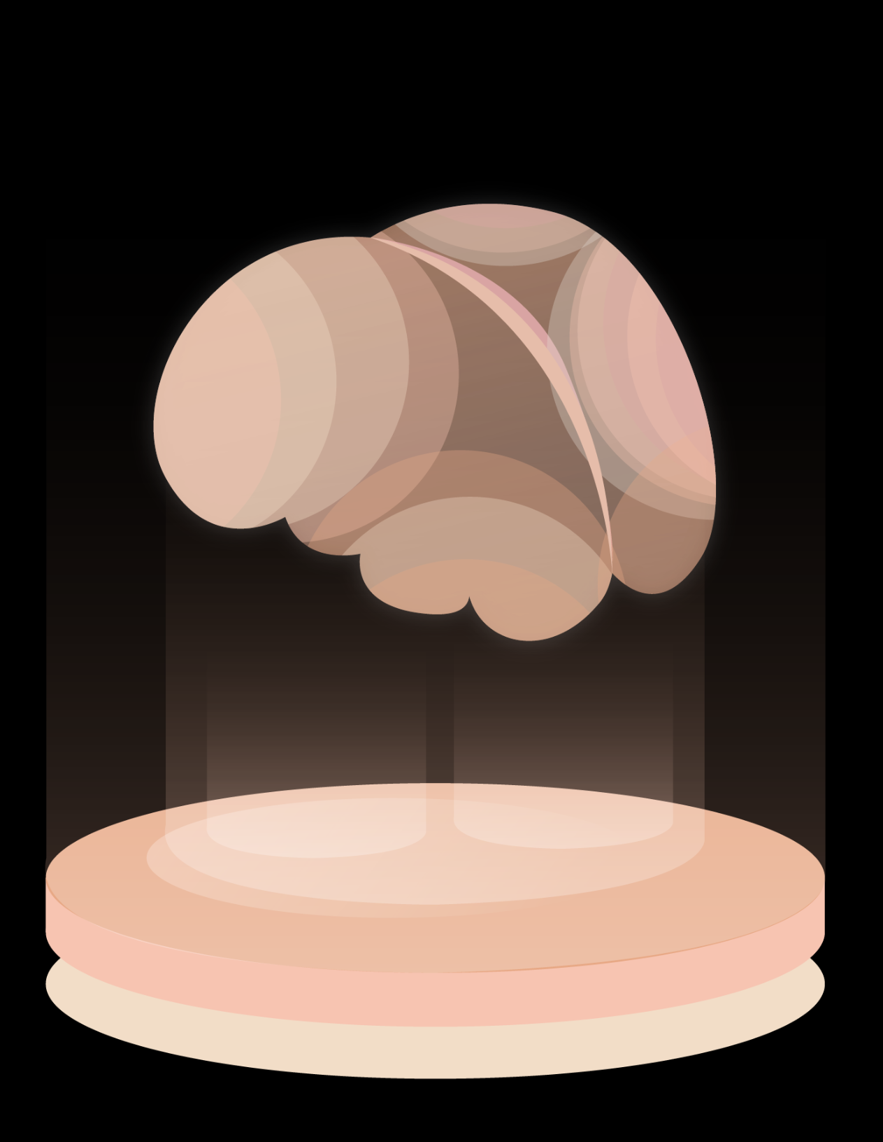
Training and Implementation in Machine Learning
Training:
Goal: Identify patterns in huge datasets.
Requirements: A high capacity for computation is needed. Real-time performance is not required.
Implementation :
Goal: Engage users directly in real time
Requirements:
1. Low latency
2. Effective utilization of computer resources

Slide 4
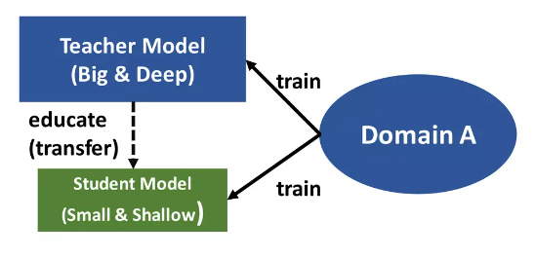
What is Knowledge Distillation?
A method for knowledge transfer from a big, complex model (teacher) to a smaller, less complex model (student)

Slide 5
Why Do We Use Knowledge Distillation?
Improve the performance and efficiency of the smaller model
Decreased computational costs
Better Generalization

Slide 6
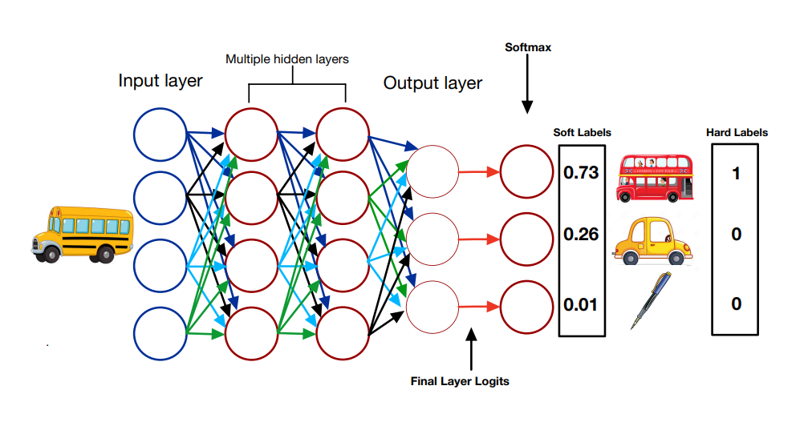
DIAGRAM

Slide 7
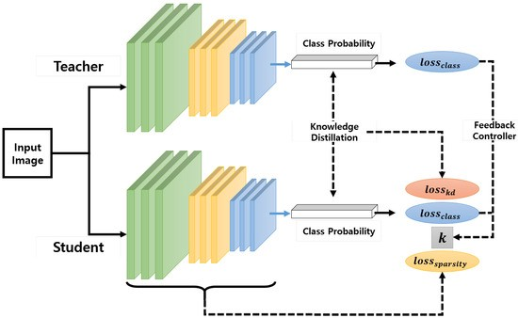
Distillation Process: or Knowledge Transfer:
Train the distilled model on a dataset (transfer set) using "soft targets" produced by the cumbersome model at a high temperature.
During training, use the same high temperature in the distilled model.
After training, switch the temperature back to 1 for the distilled model.

Slide 8
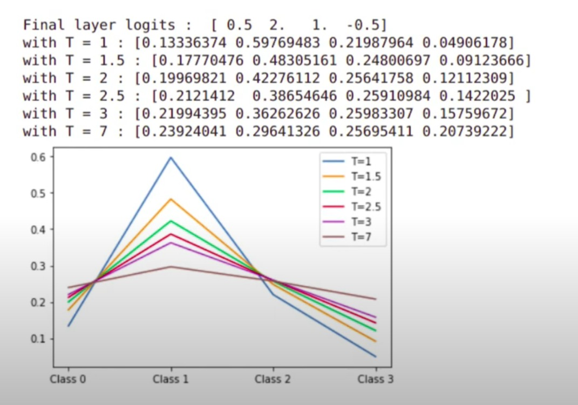
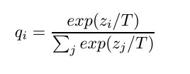
Softmax and Temperature:
Neural networks use a softmax layer to convert logits (raw scores) into probabilities for each class.
The temperature (T) parameter in the softmax function can be adjusted. A higher temperature produces a "softer" probability distribution, meaning the probabilities are more spread out and less confident.

Slide 9


Logit Matching:
Logits ($z_{i}$): The raw scores before applying softmax
Gradient Contribution: Each example in the transfer set contributes a gradient with respect to each logit of the distilled model.

Slide 10
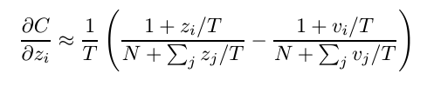

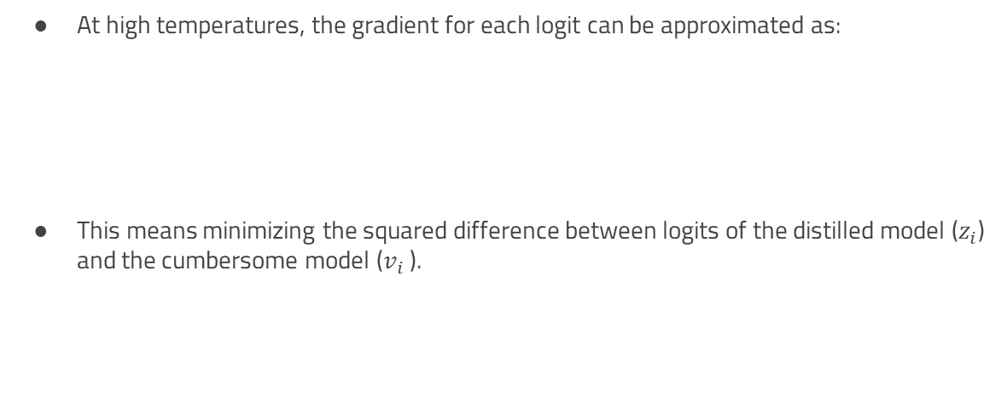
High Temperature Approximation:
At high temperatures, the gradient for each logit can be approximated as:
This means minimizing the squared difference between logits of the distilled model ($z_{i}$) and the cumbersome model ($v_{i}$ ).

Slide 11
Empirical Findings:
Intermediate temperatures often work best, especially when the distilled model is too small to capture all the knowledge from the cumbersome model
This suggests that ignoring some of the less significant logits can help the distilled model generalize better

Slide 12
Preliminary Experiments on MNIST
 | Large Neural Net | Smaller Neural Net | Distilled Model
Architecture | Two hidden layers, 1200 rectified linear units | Two hidden layers, 800 rectified linear units | Two hidden layers, 800 rectified linear units
Regularization | Dropout | None | Added task of matching soft targets from the large net at a temperature of 20
Performance | Achieved 67 test errors | Achieved 146 test errors | Achieved 74 test errors

Slide 13
Preliminary Experiments on MNIST
Effect of Temperature and Network Size:
Distilled Net (300+ units per layer): All temperatures above 8 gave similar results
Distilled Net (30 units per layer): Optimal Temperature: 2.5 to 4 worked better than higher or lower temperatures

Slide 14
Preliminary Experiments on MNIST
Handling Missing Digits (Omitting digit ‘3’)
Initial Errors: 206 test errors (133 on digit '3’)
Adjusted Bias: Increased by 3.5, reducing errors to 109 (14 on digit '3’)
With the right bias, the distilled model gets 98.6% of the test 3s correct despite never having seen a 3 during training.

Slide 15
RESOURCES
https://arxiv.org/abs/1503.02531
https://en.wikipedia.org/wiki/Knowledge_distillation
https://keras.io/examples/vision/knowledge_distillation/

Slide 16
THANK YOU FOR YOUR ATTENTION!
Feel free to ask any questions.

Slide 17
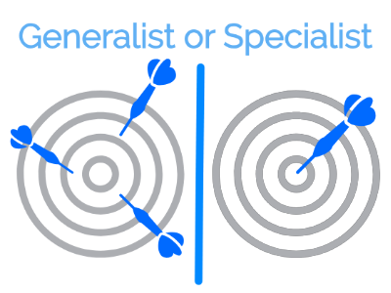
Types of Models (Generalist and Specialist):
Types of Models (Generalist and Specialist):
Generalist model: Trained using the complete dataset.
Specialist models: focuses on specific data subsets. started using the generalist model's weights to share feature detectors at a lower level.
Optimization:
Using the generalist model, determine which classes are most likely for each test case.
For precise and accurate predictions, use gradient descent to optimize the logits for each image.

Slide 18
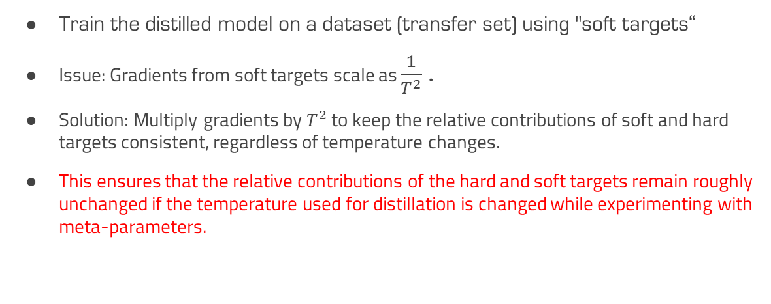
Gradient Scaling:
Train the distilled model on a dataset (transfer set) using "soft targets“
Issue: Gradients from soft targets scale as $\frac{1}{T^{2}}$ .
Solution: Multiply gradients by $T^{2}$ to keep the relative contributions of soft and hard targets consistent, regardless of temperature changes.
This ensures that the relative contributions of the hard and soft targets remain roughly unchanged if the temperature used for distillation is changed while experimenting with meta-parameters.

Slide 19
Effect of Temperature:
Lower Temperatures: Less focus on matching very negative logits, which might be noisy.
Intermediate Temperatures: Often provide the best balance, especially when the distilled model is significantly smaller than the cumbersome model.

Slide 20
Combining Soft and Hard Targets:
When correct labels are available, the distilled model can be trained to produce both the soft targets and the correct labels.
This is done using a weighted average of two objective functions: one for the soft targets and one for the correct labels.
Typically, a lower weight is given to the objective function for the correct labels to balance the contributions.

